Slide 1



Data Structure
&
Algorithm
Class IX
lab 9

Slide 2

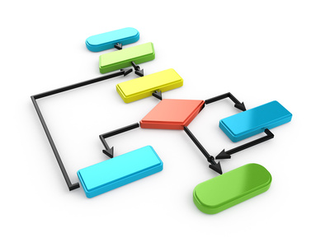
What is Algorithm
a step-by-step procedure,
which defines a set of instructions
to be executed

Slide 3
categories of algorithms
Search
Sort
Insert
Update
Delete

Slide 4
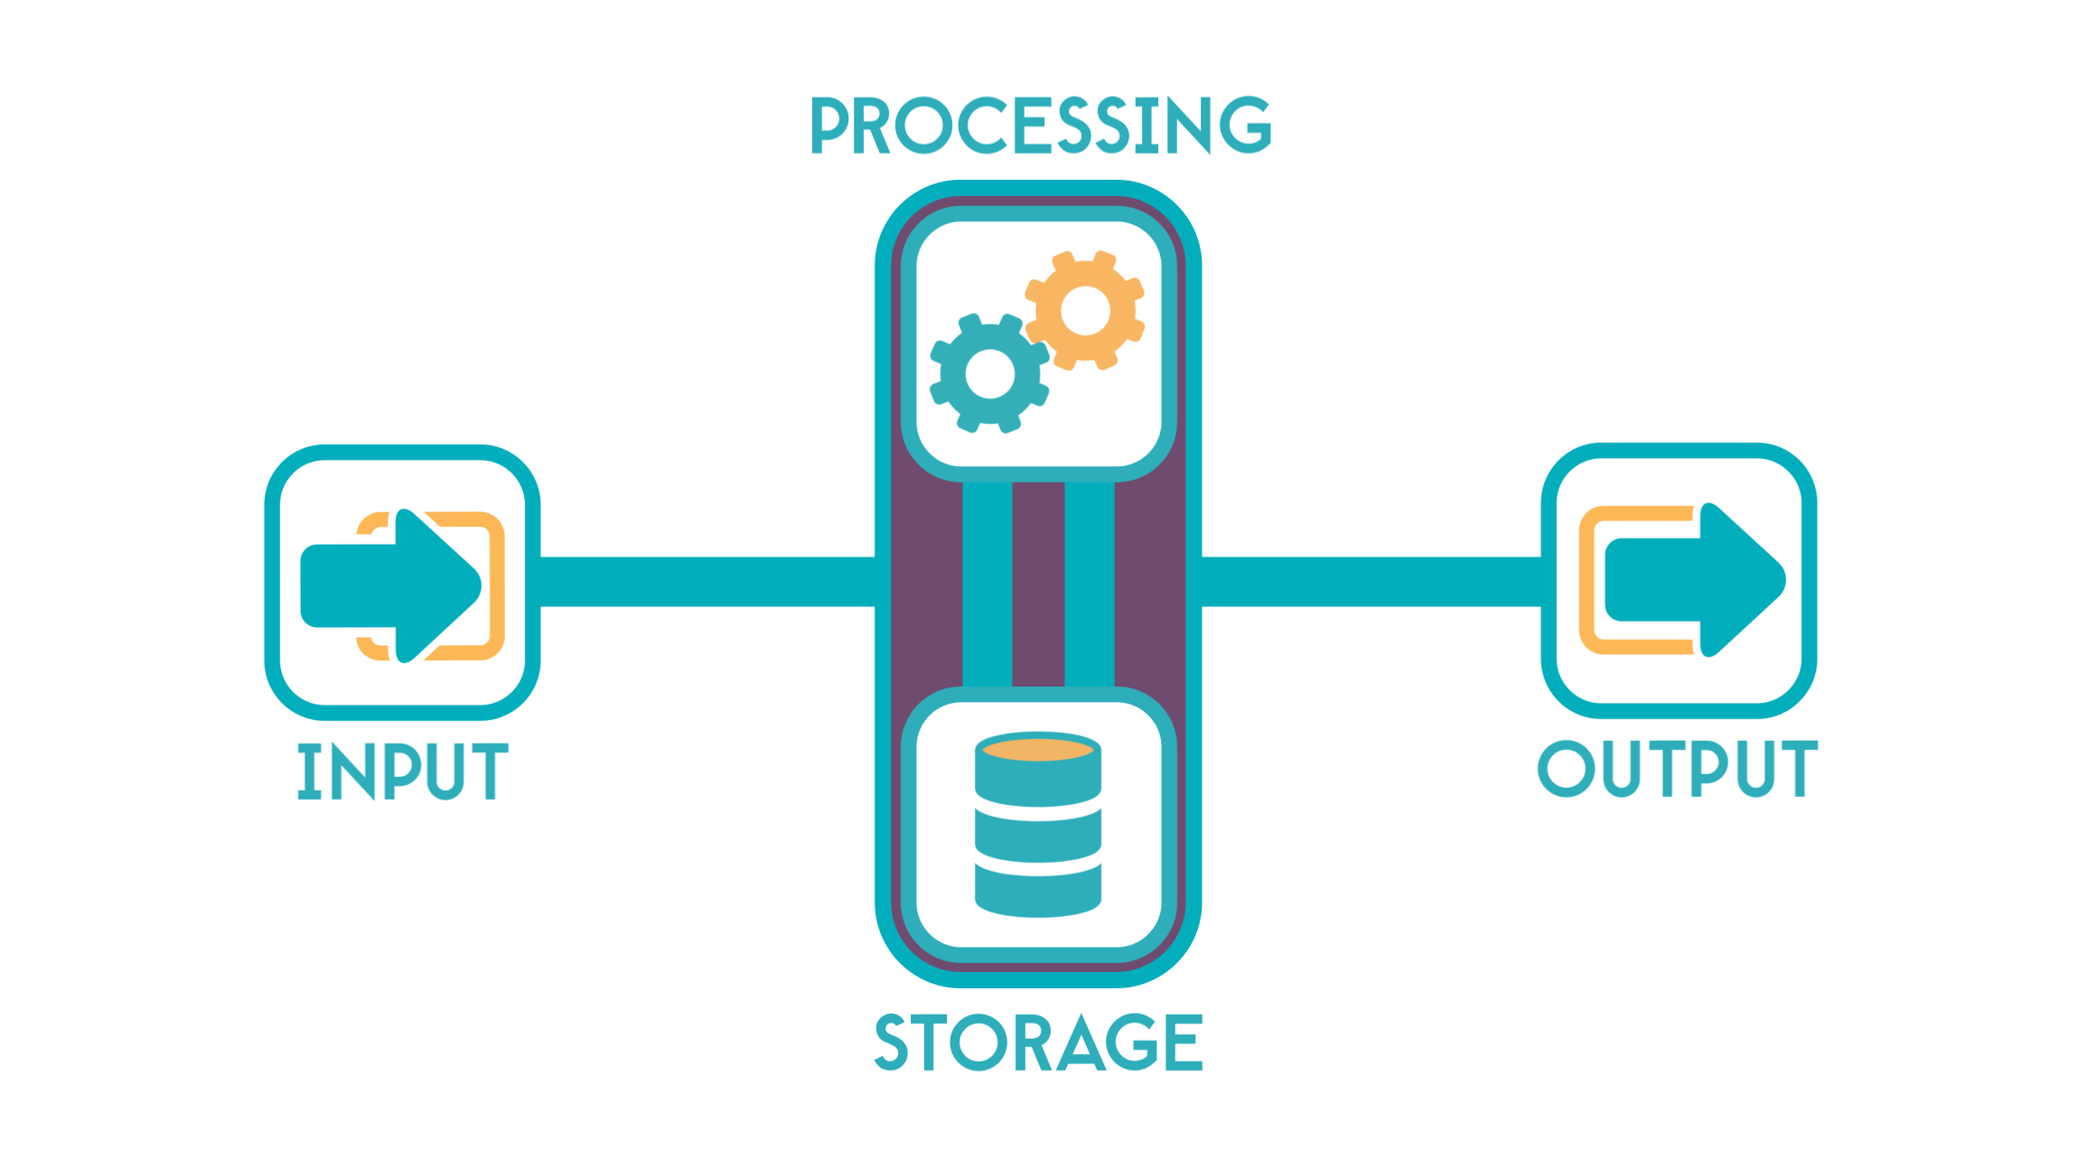
Characteristics of an Algorithm
Unambiguous
Input
Output
Finiteness
Feasibility
Independent

Slide 5
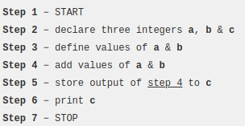
Write an Algorithm
There are no
well-defined
standards for
writing algorithms.
Algorithms are never
written to support a
particular programming code.

Slide 6
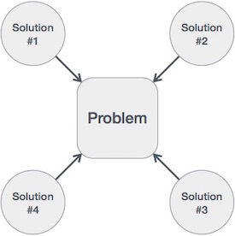
Solving a Problem
algorithm helps to
choose the best
solution of a problem

Slide 7


